Slide 1
Autonomous Intelligent Vehicle
Group members
Apoorv Waghmare
Chinmay More
Atharva Vakharkar
Project mentor
Shridhar Patil

Slide 2
Content
The concept of AIV
Use cases
Mechanical design, electronics components and software of AIV
Working
Future scope and improvements
Demo

Slide 3
Concept of AIV
Autonomous Intelligent Vehicle (AIV) is a vehicle that can travel autonomously, especially in indoor conditions without any external guidance.
AIV can localize itself in an area.
Plan a path from its current position to a target destination.
Successfully execute the planned path in a dynamic environment.

Slide 4
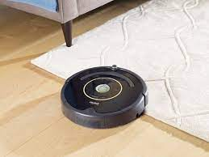
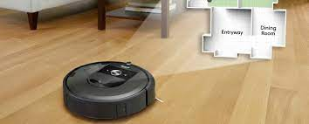
Use Cases
Vacuum cleaner “Roomba” from iRobot.

Slide 5
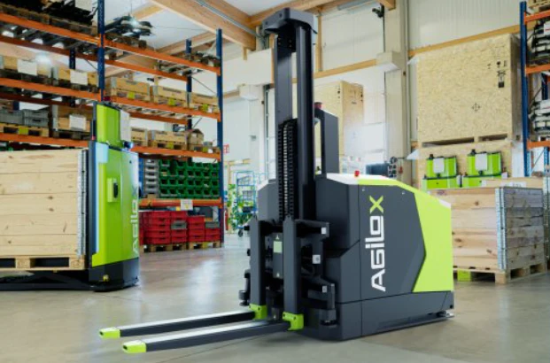
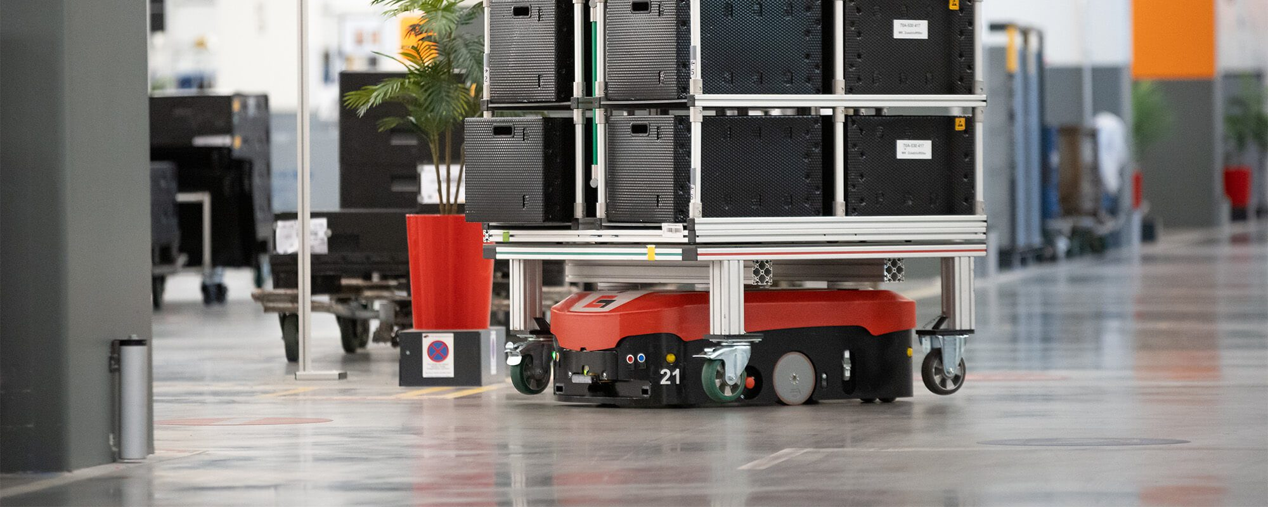
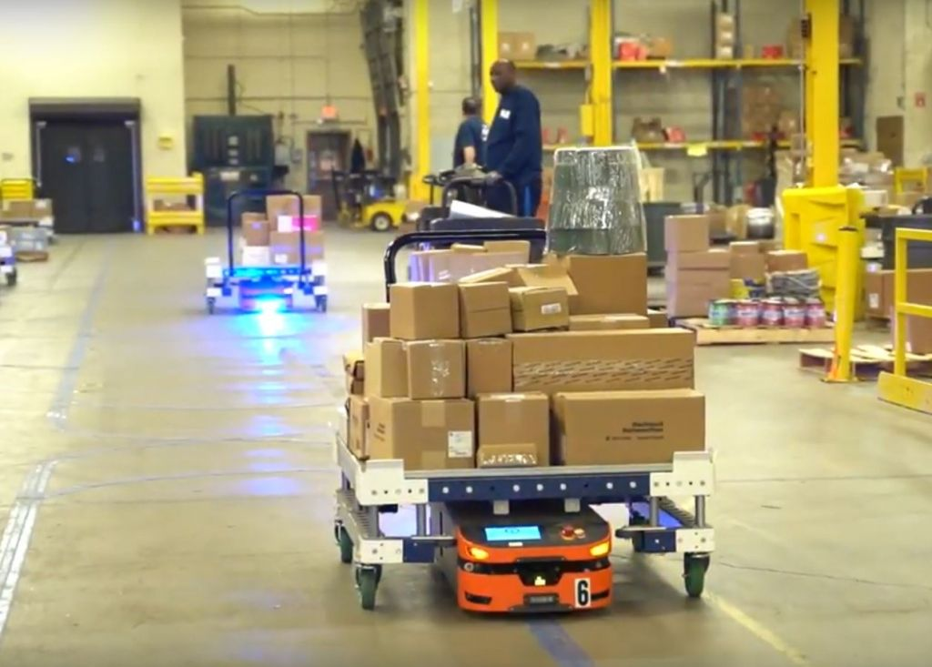
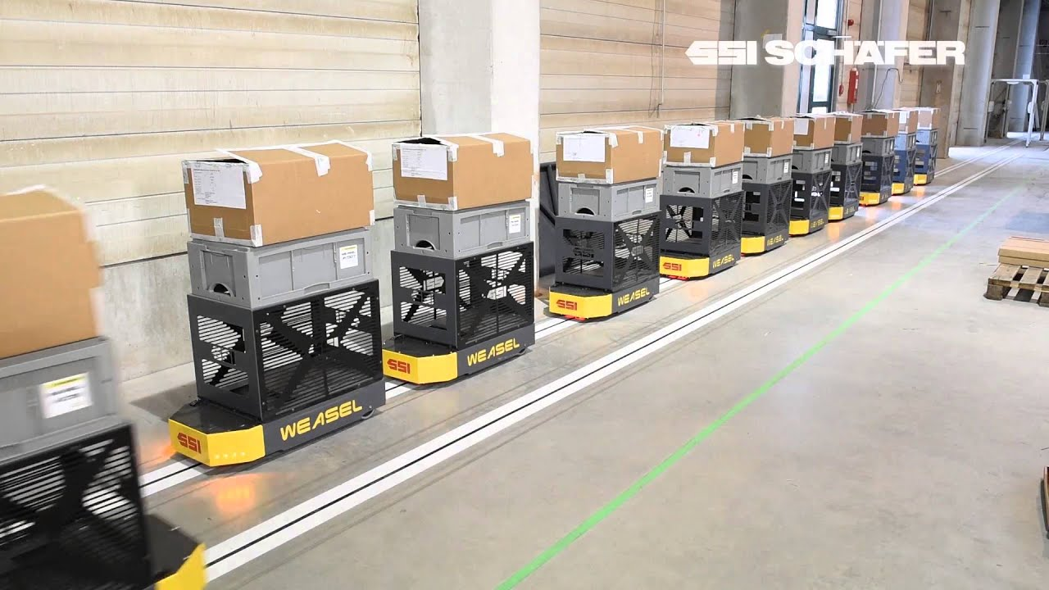
Use Cases
Autonomous forklift from Agilox.
Many other types of AIV for transporting
goods in a big store houses.

Slide 6
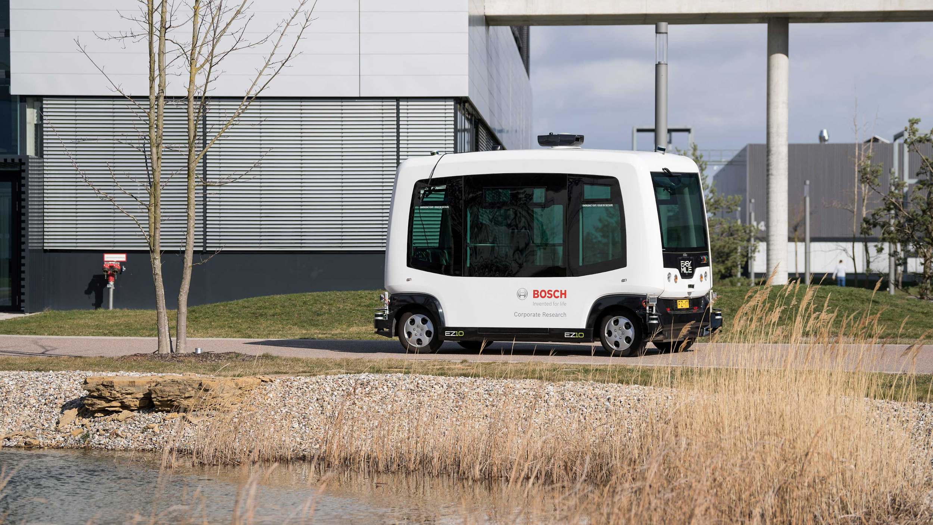
Use Cases
These type for bigger vehicles are used to transport people at some of the airports
Survey areas where it is difficult for humans to reach. e.g some hazardous parts at chemical plants.

Slide 7
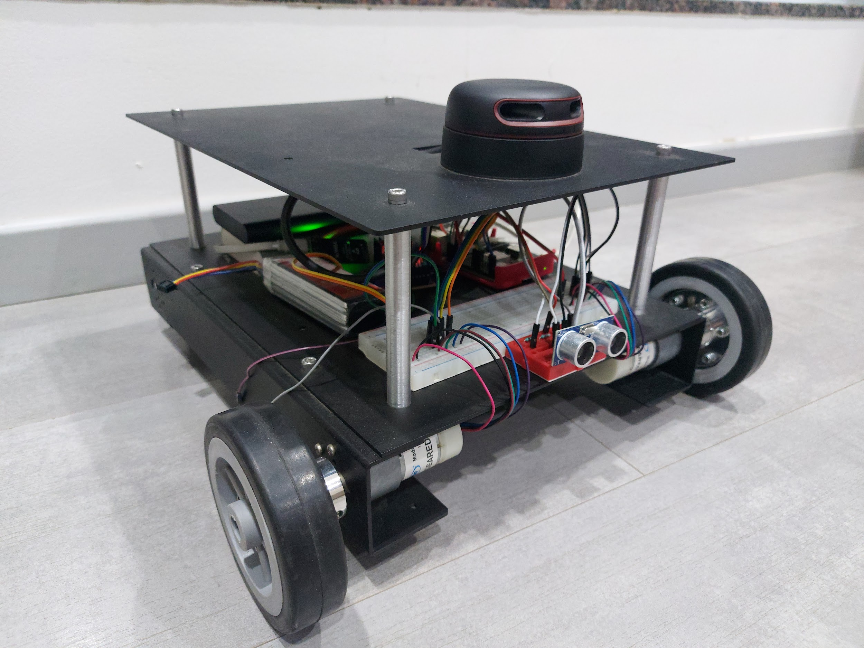
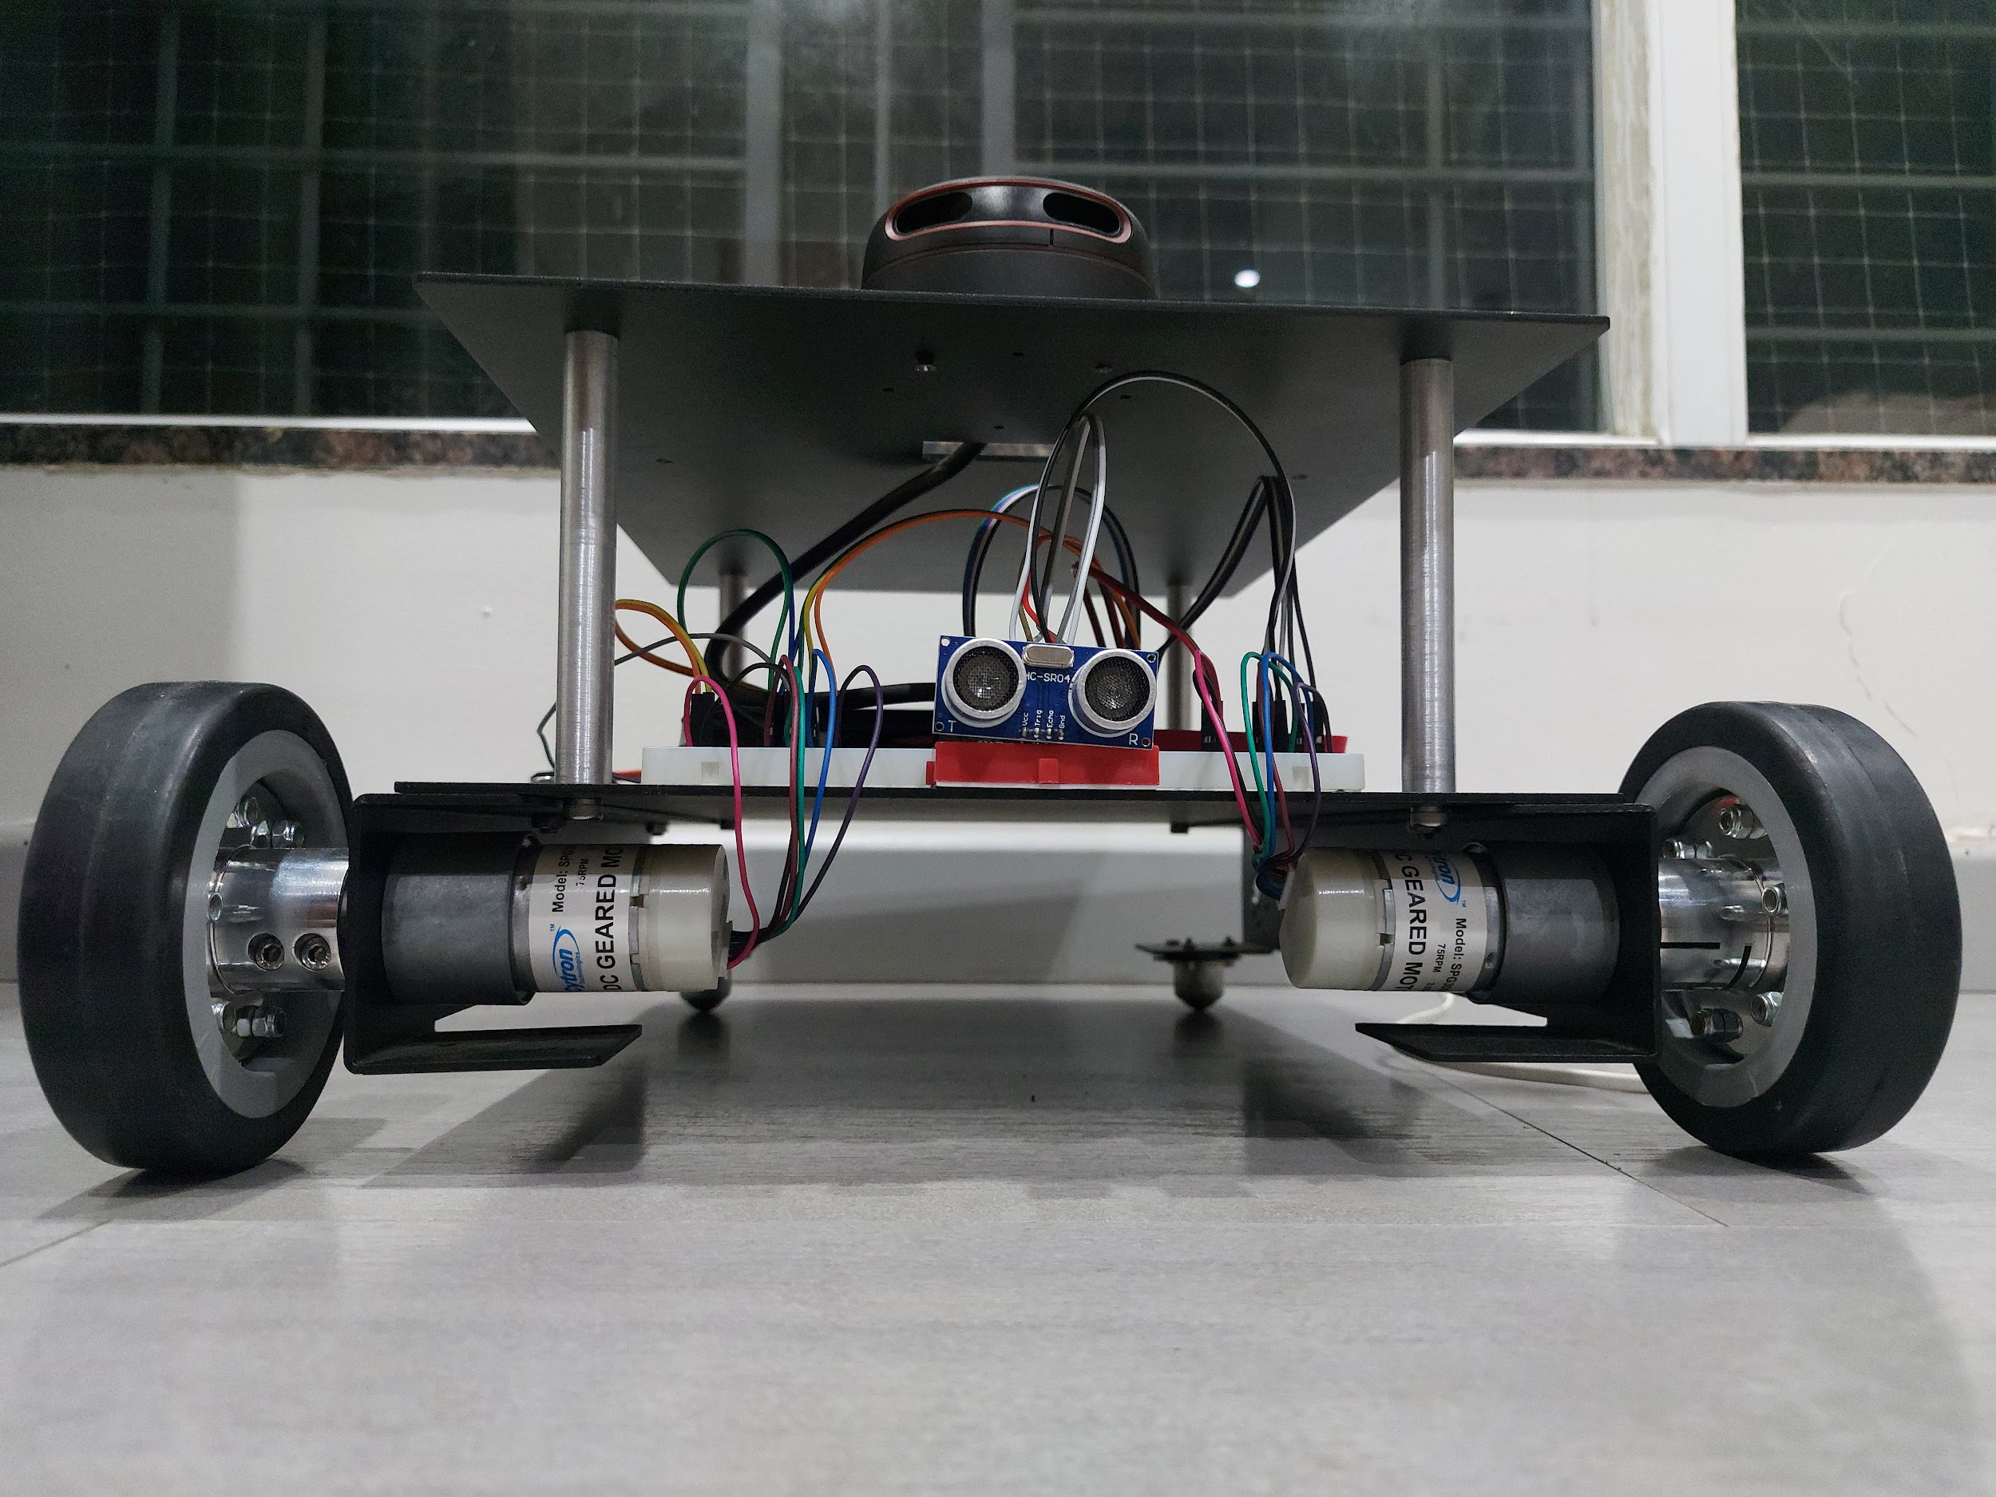
Our AIV

Slide 8
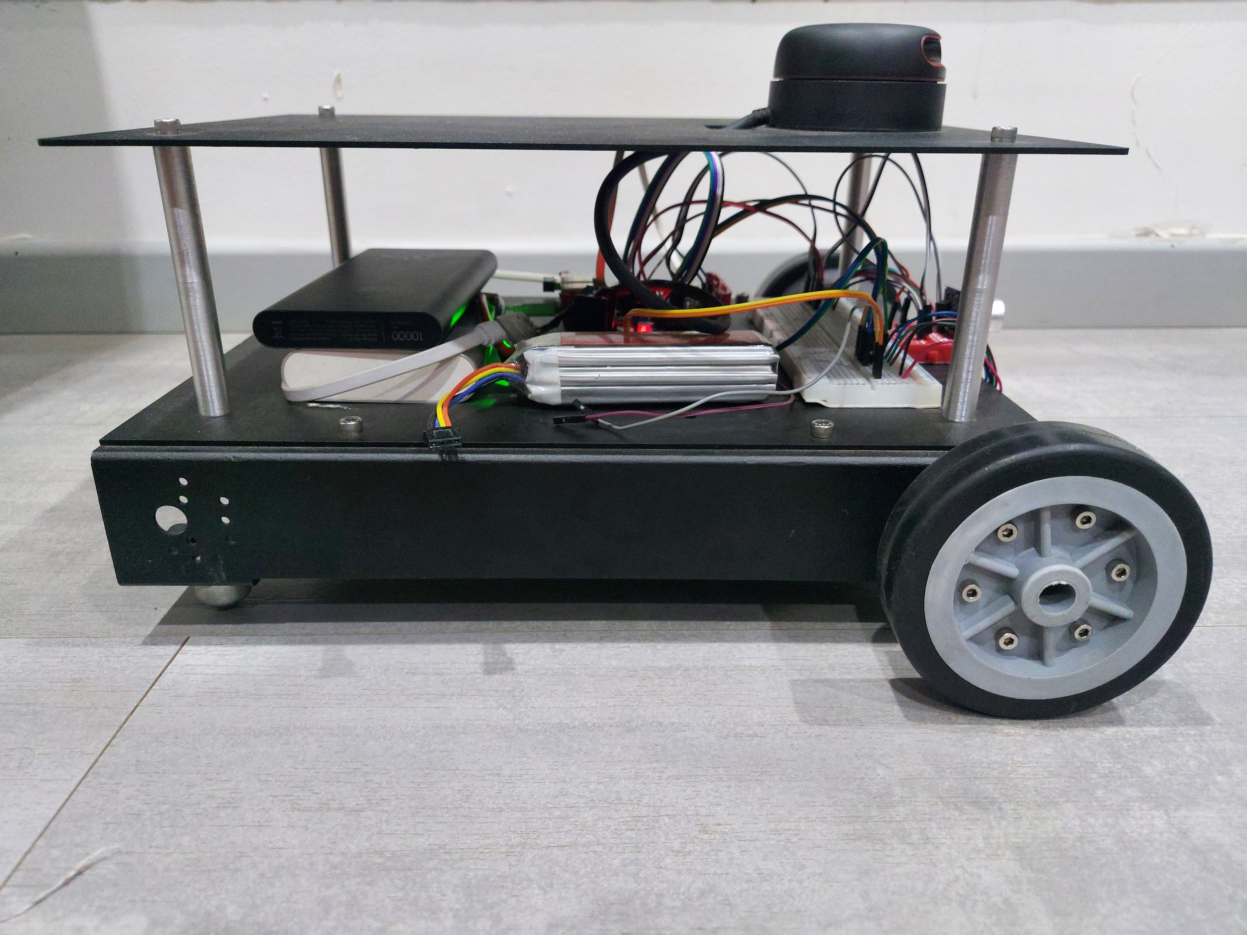
Design
Double deck
Front wheel drive
Bot rear wheels are castor wheels

Slide 9
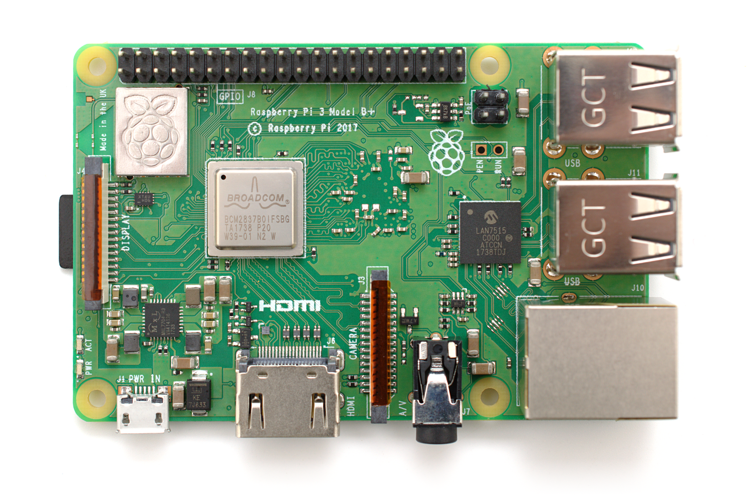
Electronic components
Raspberry Pi 3b+ microprocessor
Runs on Linux based Raspbian operating system
It can control electronic actuators and acquire data from sensors.

Slide 10
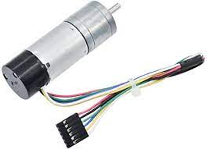
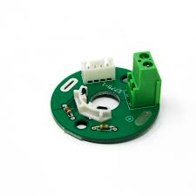
Electronic components
Encoded motors
Encoded motors gives us the instantaneous RPM of the motor
The sensor works on hall effect principle

Slide 11
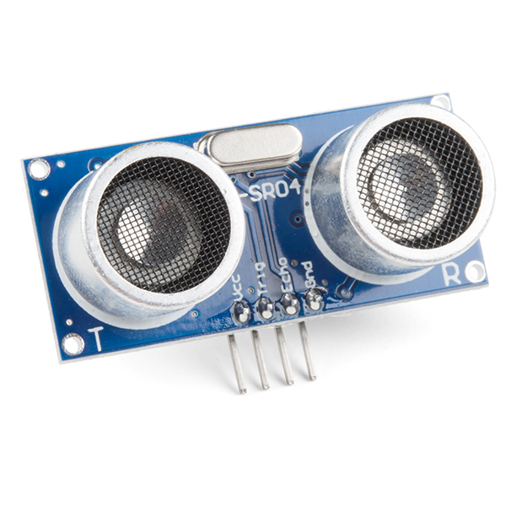
Electronic components
Proximity sensor
It is an ultrasonic sensor.
It will be used to detect obstacles.

Slide 12
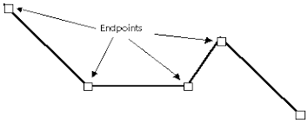
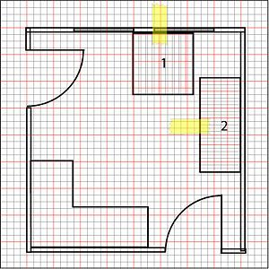
Important Functionalities
Map building
Path planning
Path execution
Dynamic map updating

Slide 13
Cartography
Main purpose of a map is path planning and navigation.
For this process the dimensions of the area of operation are to be fed to the AIV.

Slide 14
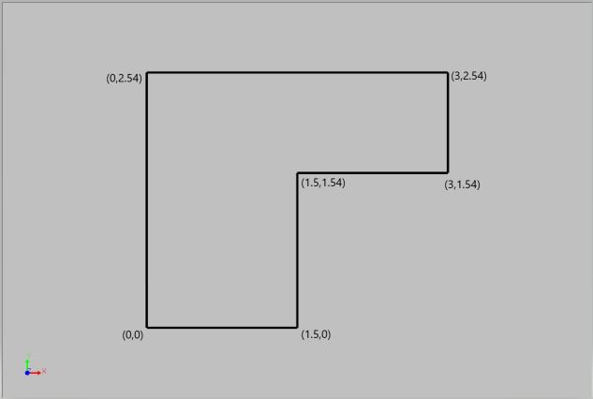
Map Polygon

Slide 15
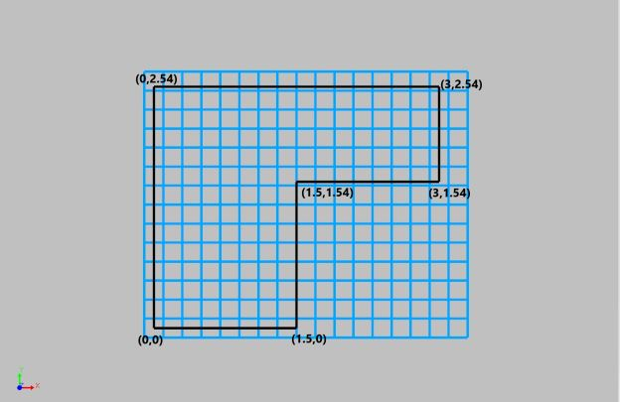
Full Grid

Slide 16
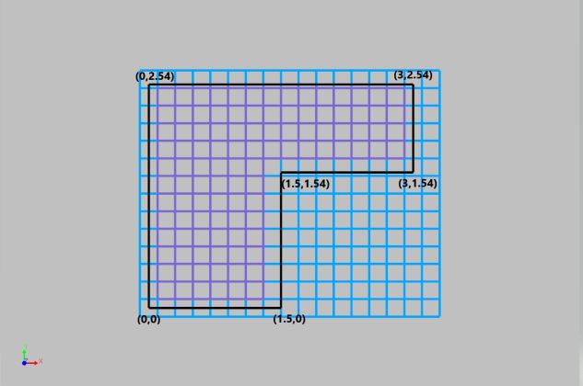
Valid Grid

Slide 17
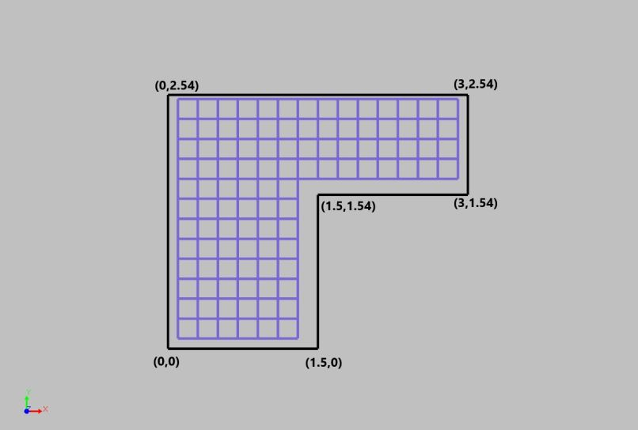
Workspace

Slide 18
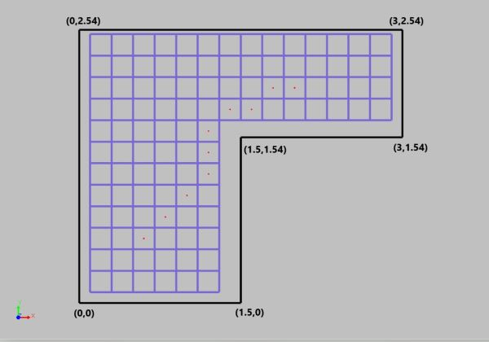
Path planning using A-Star algorithm

Slide 19
PolyLine Execution
AIV performs two types of motions
Linear motion
Inplace rotation
We measure omega(w) of each motor using encoded motors.
We find instantaneous velocity vector of each wheel individually.
Using this two velocity vectors we can find instantaneous velocity of the AIV.

Slide 20
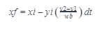
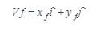
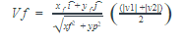
Instantaneous Vector

Slide 21
Dynamic Map Building Updating Algorithm
The Working environment will not be always static. There will be some static and dynamic obstacles present in the working area.
To overcome this we have developed this algorithm to keep the checks on this obstacles

Slide 22
Dynamic Map Building Updating Algorithm
Each cell has a accessibility status
Active
Inactive
Each cell gets three penalties.
Obstacle is detected using proximity sensor.
This is done by constantly checking and updating the status of the active and inactive cells by the location of obstacles.

Slide 23
Improvements
Implementing a good feedback system and increase the accuracy of the AIV.
Improving mechanical aspects of the AIV.
Integrating lidar sensor for localization of AIV, especially when AIV starts.

Slide 24
Thank You

